Slide 1
Lodge-Gossett Amendment to the Electoral College System

Slide 2
Proportional Allocation of Electoral Votes
Section 1
The electoral college system of electing the President and Vice President of the United States is hereby abolished.
Each person for whom votes were cast for President in each State shall be credited with such proportion of the electoral votes thereof as he received of the total vote of the electors therein for President.
In making the computation, fractional numbers less than one one-thousandth shall be disregarded unless a more detailed number of electoral votes for President shall be President.
If two or more persons shall have an equal and the highest number of such votes, then the one for whom the greatest number of popular votes were cast shall be President.

Slide 3
Goals of the Amendment
Henry Cabot Lodge: “The basic principle underlying this reform is an attempt more exactly to reflect the will of the people.”
Why not the direct election of the President?
Lodge: ”[The direct election of the President] runs into the practical difficulty that it violates the Federal principle of equality of the States in the Senate in that the two-vote “bonus” which gives the States with small populations a small relative advantage would be abolished. The pending proposal completely protects the position of the so-called small states.”

Slide 4
Goals of the Amendment
Eliminate the winner-take-all system – the so-called unit rule
Lodge: ”The unit rule is neither fair, accurate, nor democratic. The votes cast for the losing candidate are of no more effect than if they had never been cast. Under our proposed amendment, every popular vote would count.”
Redresses the electoral college system’s “evil” perpetuation of the so-called ”pivotal State” (what we now term, “battleground states”
Lodge: “The unit rule tends to build up special local blocs, which tend to receive a disproportionate amount of attention whereas other parts of the country receive little or no attention.”

Slide 5
Goals of the Amendment
Two-party presidential election competition throughout the country
Lodge: ”If the voters have an incentive to vote because they know their votes will count, we can expect that each party will seek to build up its membership and get the largest popular number of voters to the polls in November. This would mean a real two-party system in the South and in other so-called solid areas where the unit rule has perpetuated one-party government…. [This amendment] brings all sections of the country into the field of Presidential politics.”

Slide 6
Goals of the Amendment
Getting rid of the electoral college system’s provision for involvement of the House of Representatives in presidential elections
Lodge: “In the three times in our history when elections have been decided in the House, a most volatile situation has always resulted…. [Through this amendment] we remove one of the most troublesome sort spots of our electoral procedure.”

Slide 7
Does Proportional Allocation better reflect the will of the people?
For the most part…
2020 Election Results
Popular Vote:
Biden: 51.4%
Trump: 46.9%
Electoral College vote percentage allocation
Biden: 56.9%
Trump: 43.1%
Lodge-Gossett Proportional Electoral Vote allocation
Biden: 50.8%
Trump: 47.3%

Slide 8
Does Proportional Allocation better reflect the will of the people?
For the most part…
2016 Election Results
Popular Vote:
Clinton: 48.6%
Trump: 46.5%
Electoral College vote percentage allocation
Clinton: 42.2%
Trump: 56.5%
Lodge-Gossett Proportional Electoral Vote allocation
Clinton: 48%
Trump: 46.8%

Slide 9
Does Proportional Allocation better reflect the will of the people?
But…
2000 Election Results
Popular Vote:
Bush: 47.9%
Gore: 48.4%
Electoral College vote percentage allocation
Bush 50.4%
Gore: 49.4%
Lodge-Gossett Proportional Electoral Vote allocation
Bush: 48.2%
Gore: 48%

Slide 10
Does Proportional Allocation address the swing state problem?
The Swing state – under the winner-take-all system, the marginal voter in a competitive battleground state is much more valuable than the marginal vote in a non-competitive state
Since 2000, in only 15 states have both Democratic presidential candidates and Republican presidential candidates won an election at least once (in the 35 other states, one party’s presidential candidate has won all the elections)
Those 15 states include only 37 percent of the population (2020 census data)
In 2016, there were 12 swing states and 2 swing districts representing 26 percent of the population (2020 census data)
In 2020, there were 13 swing states representing 41 percent of the population.
In 2024, pundits suggest that there will be only six swing states representing 15% of the population.

Slide 11
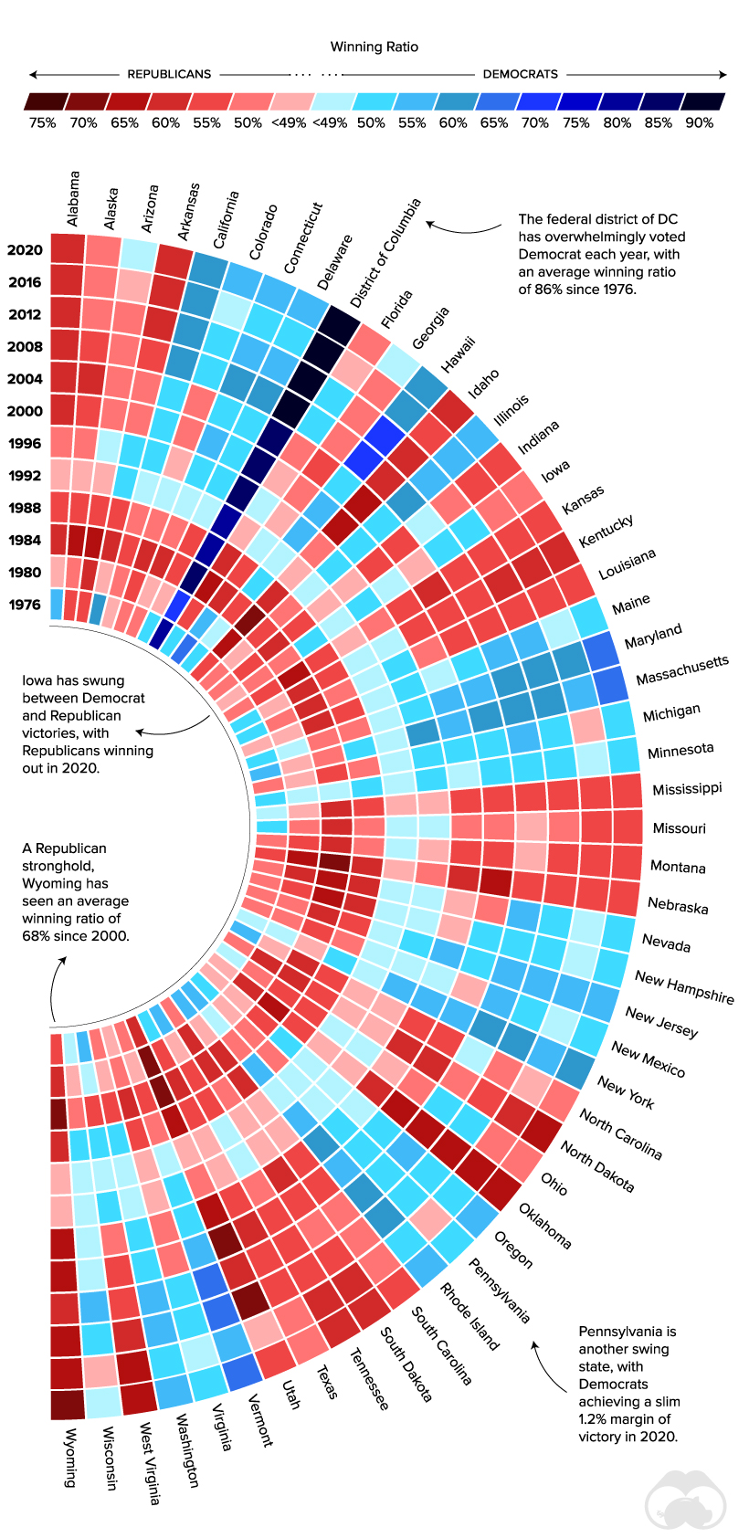

Slide 12
Does Proportional Allocation address the swing state problem?

Slide 13
Does Proportional Allocation address the swing state problem?

Slide 14
Does Proportional Allocation address the swing state problem?

Slide 15
Does Proportional Allocation address the swing state problem?
Maybe….
If we assume that states have an equal number of electoral votes, the marginal vote in a competitive state is no more valuable than a marginal vote in an uncompetitive state
The unequal number of electoral votes for each state based on population and the Senate ”bonus” means marginal votes vary in value on the basis of the size of the state
California (a state with 55 EVs): An increase from 50 to 51% of the popular vote yields a gain of .55 electoral votes
To achieve the same .55 electoral vote gain in Idaho (a state with 4 EVs), a candidate will need to increase their popular vote count from 50 to 64%
Using 2020 turnout figures, in California, an increase from 50 to 51% of the popular vote is the equivalent of 171,167 votes
Using 2020 turnout figures, in Idaho, an increase from 50 to 64% of the popular vote is the equivalent of 117,760 votes

Slide 16
Does Proportional Allocation reduce the third-party spoiler effect?
Not clear…
1992 Election Results
Popular Vote:
Clinton: 43%
Bush: 37.4%
Perot 18.9%
Electoral College vote percentage allocation
Clinton 68.8%
Bush: 31.2%
Perot: 0%
Lodge-Gossett Proportional Electoral Vote allocation
Clinton 42.9%
Bush: 37.6%
Perot: 18.9%

